Slide 1

Skills and roles of a manager

Slide 2

Skills of a manager
Communication and interpersonal skills
Listening skills
Relationship building skills
Emotional intelligence
Organisation and project management
Strategic thinking
Decision making

Slide 3

Skills of a manager
Conflict resolution
Time management
Delegation
Motivation
Recognition
Confidence
Vision

Slide 4

Skills of a manager
Trustworthiness and respect
Teamwork
Team orientation
Problem solving
Functional skills
Technological skills
Adaptability

Slide 5

What skills do you possess?

Slide 6
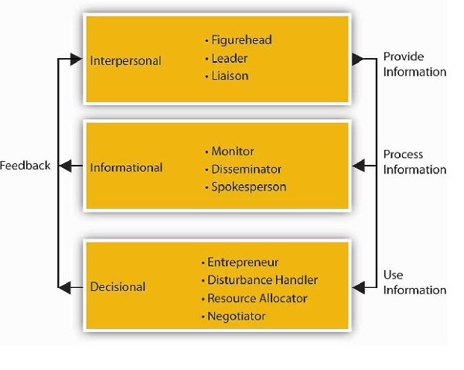
Roles of a Manager

Slide 7
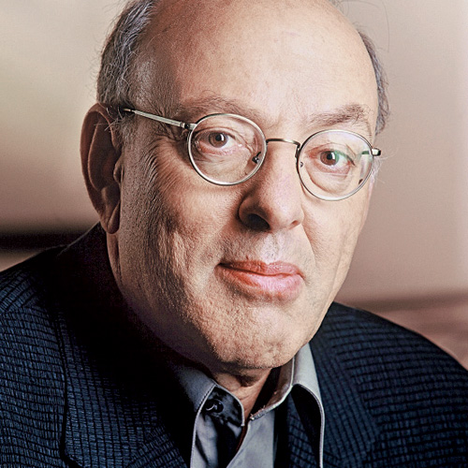
WHO CAME UP WITH THIS CONCEPT?
Mintzberg published his Ten Management Roles in his book, "Mintzberg on Management: Inside our Strange World of Organizations," in 1990

Slide 8
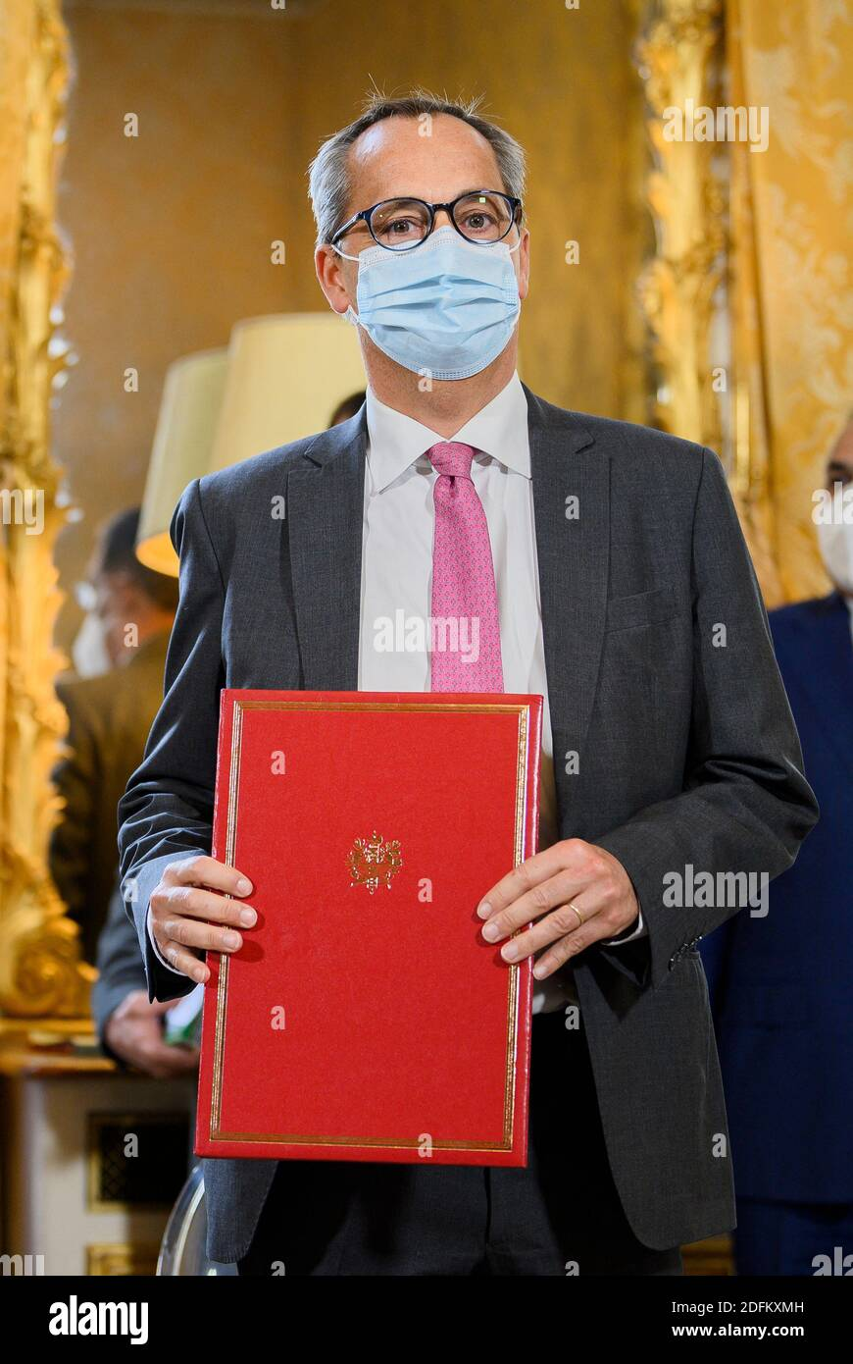
INTERPERSONAL ROLES
Figurehead
A manager plays a figurehead role when he performs activities such as attending ceremonial functions which have symbolic nature.
Sometimes managers greet visitors, attend social functions involving employees, and handling out merit certificates and other awards to outstanding employees.
Notes:
interacting with people inside and outside the organization.

Slide 9
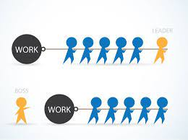
INTERPERSONAL ROLES
Leader
The leader role of a manager involves leading and motivating his subordinates for willing contribution. Managers perform leader roles when they perform activities such as Hiring, Training, motivating, and guiding subordinates.

Slide 10

INTERPERSONAL ROLES
Liaison
In the Liaison role, the manager act as a mediator between the organization and the outsider.
He serves as a connecting link between his units and organizational units, and sometimes with people from the external environment.

Slide 11

INFORMATIONAL ROLES
Monitor
The manager seeks and receives information about those factors which affect his activities. These factors may be within the organization as well as outside it.
By playing a monitor role, Managers gain an understanding of the Organization and its environment.
Notes:
ike serving as a focal point for the exchange of information. It includes communication, giving, and receiving information, both within and outside the organization. Information is required at every level in an organization to make decisions effective.

Slide 12
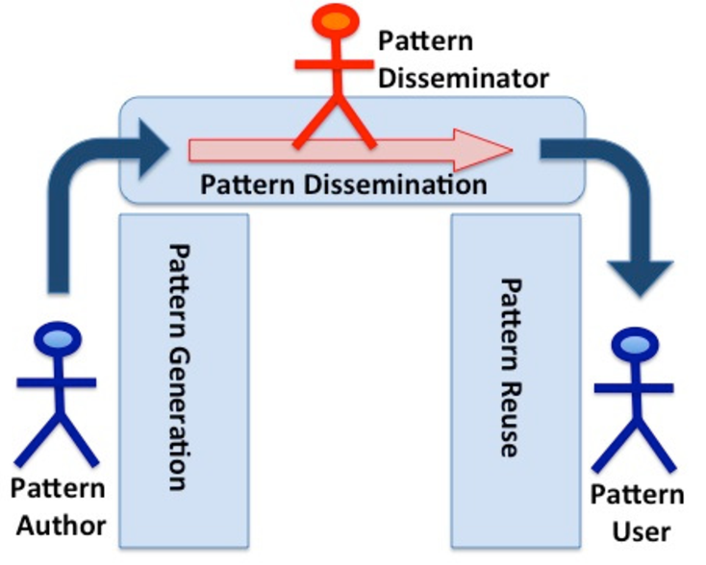
INFORMATIONAL ROLES
Disseminator
In the disseminator role, the manager transmits information to subordinates, peers, and superiors within the Organization.
The manager has to act as a disseminator and distributes the information to his subordinates because they may not be in a position to collect it.

Slide 13

INFORMATIONAL ROLES
Spokesperson
In the spokesperson role, the manager represents his organization or unit while interacting with outsiders.
More precisely, the Spokesperson Speaks on behalf of the Organization and transmits information on Organization plans, policies, and actions to outsiders.

Slide 14

DECISIONAL ROLES
Entrepreneur
Manager as an Entrepreneur role, take initiative and make changes or improvements in the activities of the Organization.
The manager assumes certain risk which is involved in terms of the outcomes of action because these are affected by a variety of external factors.
Notes:
choosing the most appropriate and best alternative out of the available ones so that the organization achieves its objectives when the chosen alternative is put into action.

Slide 15
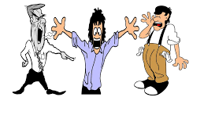
DECISIONAL ROLES
Disturbance handler
As a role of disturbance handler, the manager has in charge and takes corrective action when Organization faces unexpected crises.
The manager is required to tackle those forces and events which tend to disturb the organizational equilibrium and normal functioning.

Slide 16

DECISIONAL ROLES
Resource allocator
A manager as the resource allocator role must divide work and delegate authority among his subordinates. He must decide who will get what work.
The manager allocates resources such as human, physical and financial among his subordinates.

Slide 17

DECISIONAL ROLES
Negotiator
the manager represents the organization in bargaining and negotiations with outsiders as well as insiders.
In the negotiator role, the manager negotiates with various interest groups in the organization. Such interest groups are shareholders, employees, and outside agencies.

Slide 18

WHICH ROLE AS PER YOUR UNDERSTANDING IS THE MOST IMPORTANT OF ALL?

